Slide 1
Lecture 6: High-order Functions
CS299 - Yang

Slide 2
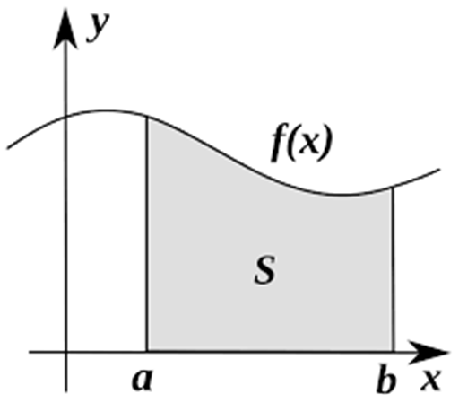
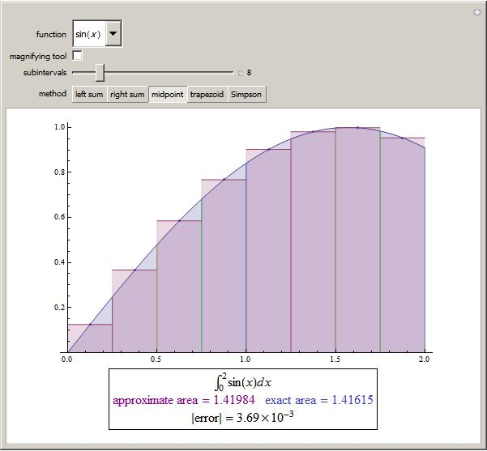
Motivation: Integration
def integration (f, a, b, n) :
sum = 0
w = 0.25
a = 0
for x in range (0, n) :
b = a + w
sum += (f(a) +f(b))/2.0 *w
a += w
return sum

Slide 3
More Examples
Sorting
Sort a list in ascending order
Sort a list in descending order
Sort a list of (name, age) according to age
Sort a list of (name, age) according to name
PA3: sort a list of (coefficient, power) in descending order of power
((2 3) (4 7) (5 1)) -> ((4, 7) (2 3) (5 1))
…

Slide 4
Higher-order Functions
In mathematics and computer science, a higher-order function (also functional, functional form or functor) is a function that does at least one of the following:
takes one or more functions as arguments
returns a function as its result
(note: definition may vary; here we focus on functions as arguments )
All other functions are first-order functions.

Slide 5
Anonymous Functions and lambda expression
In computer programming, an anonymous function (function literal, lambda abstraction, or lambda expression) is a function definition that is not bound to an identifier (i.e. no function name), it typically used
as arguments being passed to higher-order functions, or
for constructing the result of a higher-order function that needs to return a function.

Slide 6
Anonymous Function: Examples https://en.wikipedia.org/wiki/Anonymous_function
>>> a = ['house', 'car', 'bike']
>>> a.sort(key=lambda x: len(x))
>>> print(a)
['car', 'bike', 'house']
#Question: why not use
>>>a.sort(key=len(x))
>>>a.sort(key=len)

Slide 7
Return a function
def comp(threshold):
return lambda x: x < threshold
>>> func_a = comp(10)
>>> func_b = comp(20)
>>> print(func_a(5), func_a(8), func_a(13), func_a(21))
True True False False
>>> print(func_b(5), func_b(8), func_b(13), func_b(21))
True True True False

Slide 8
Currying
Currying: from f(x,y), create a curried representative notation h, h_{x}(y) = f(x,y)
>>> def divide(x, y):
return x / y
>>> def divisor(d):
return lambda x: divide(x, d)
>>> half = divisor(2) #half = divide(x,2) = x/2
>>> third = divisor(3) #third = divide(x,3) = x/3
>>> print(half(32), third(32))
16.0 10.666666666666666
>>> print(half(40), third(40))
20.0 13.333333333333334

Slide 9
Higher-order Functions in Python
Can functions be used as arguments?
In Python, functions are no difference than objects
>>> def foo () :
… print (“in foo()”)
>>> bar = foo #function object assignment
>>> bar() #calling bar() same as foo()
Passing a function as argument
>>> def hf (argfun) :
… argfun() #calling argfun here
… print (“back to hf”)
>>> hf (foo) #passing foo as a parameter

Slide 10
Passing built-in functions
def convert (func, seq) :
“convert seq. of numbers to same type”
return [func (eachNum) for eachNum in seq]
myseq = (123, 45.67, -6.2e-1, 50)
print (convert (int, myseq))
print (convert (float, myseq))

Slide 11
Higher-order Function: Example
def isSym(x,f): if (f(x) == f(-x)): return True else: return False def square(n): return(n*n) def cube(n): return(n*n*n) print ( isSym(2,square)) print (isSym(2,cube))‏
Output: True False

Slide 12
Practice
Integration
Sorting (with order function as parameter)

Slide 13
Anonymous Functions
Create anonymous function (i.e. a function without name) using lambda keyword
Format
lambda arg1, …, argn : expression
Examples
def add (x, y) : return x + y ⬄
lambda x, y : x + y
def add2 (x, y=2) : return x + y ⬄
lambda x, y=2 : x + y

Slide 14
Lambda function vs. regular function -- simple example
>>> def sum(x,y): return x+y >>> ... >>> sum(1,2) 3 >>> sum2 = lambda x, y: x+y >>> sum2(1,2) 3

Slide 15
Built-in (higher-order) Functions
filter(func, seq)
invokes Boolean function func to each element of the sequence, returns a sequence of those elements for which func returns True
map(func, seq_1, …, seq_n)
apply func to each element of given sequence(s)
reduce(func, seq)
has been dropped from Python3, but can import functools in order to use reduce()

Slide 16
map()
Map calls a given function on every element of a sequence def double(x): return x*2 a = [1, 2, 3] print (list(map(double, a))) [2, 4, 6]
Alternatively: print (list(map((lambda x: x*2), a))) [2, 4, 6]
Working with two or more lists
print (list(map((lambda x, y: x+y), [1,2,3], [4,5,6]))) [5,7,9]

Slide 17
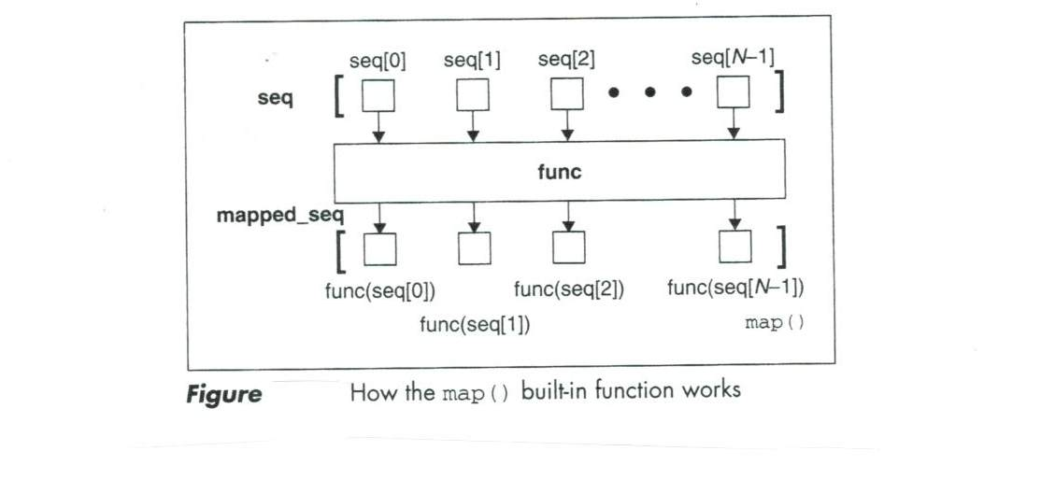
How map() works

Slide 18
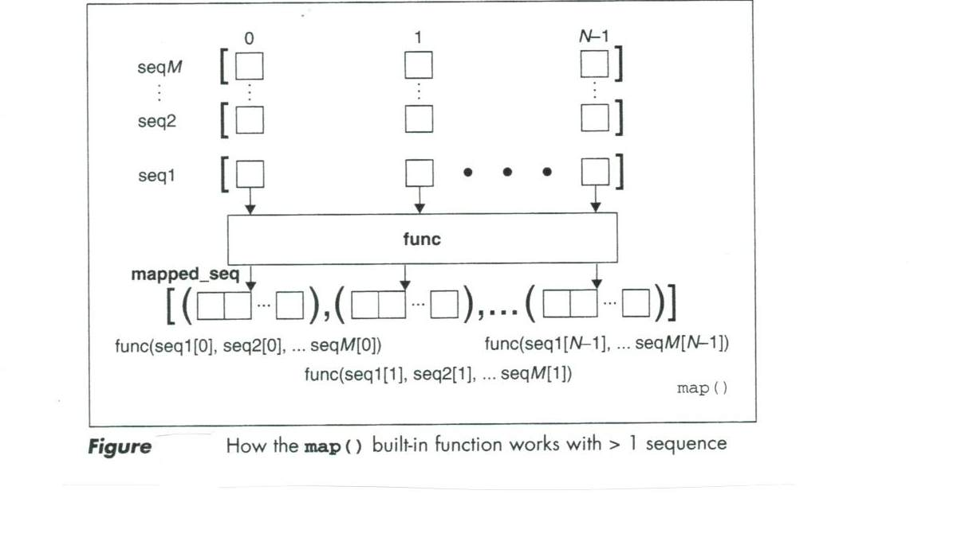
How map() works with multiple sequences

Slide 19
map(): functionality description
def map(func, seq) :
result = []
for item in seq : #for each item
result.append(func(item))
return result

Slide 20
Examples
>>> add_one = list (map(lambda x : x + 1, [1, 3, 5]))
>>> result = list(map (lambda x, y : x + y, [1, 3, 5], [2, 4, 6]))
#why here need 2 sequences as arguments?
>>> result = list(map(lambda x, y : (x+y, x-y), [1, 3, 5], [2, 4, 6]))
>>> def add2 (x) : return x + 2
>>> result = list(map(add2, [1, 3, 5]))

Slide 21
filter()
Like map, the filter function works on lists. Unlike map, it returns only a selected list of items that matches some criterion.
Get only even numbers: filter((lambda x: x%2==0), range(-4,4)) [-4, -2, 0, 2] # note: range doesn't include last value

Slide 22
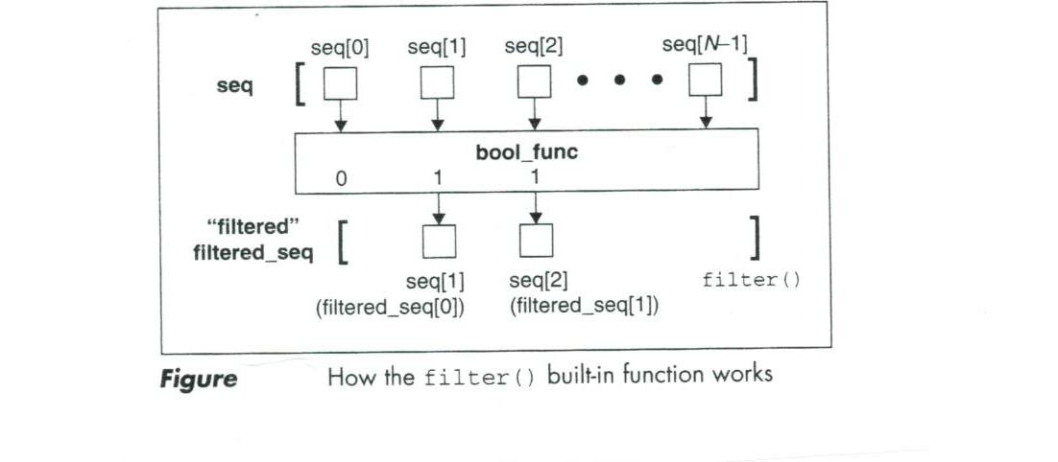
How filter() works

Slide 23
Examples
>>> fibonacci = [0,1,1,2,3,5,8,13,21,34,55]
>>> odd_numbers = list(filter(lambda x: x % 2 == 1, fibonacci))
>>> print(odd_numbers)
>>> even_numbers = list(filter(lambda x: x % 2 == 0, fibonacci))
>>> print(even_numbers)
def even (x) :
if (x % 2 ==0) :
return True
else :
return False
evens = list (filter(even, fibonacci))

Slide 24
filter(): Functionality description
def filter (bool_f, seq) :
result = []
for item in seq : #for each item
if bool_f(item) :
result.append(item)
return result

Slide 25
map/filter functionality in list operations
>>> [x**2 for x in range(9)] #map
[0, 1, 4, 9, 16, 25, 36, 49, 64]
>>> [x**2 for x in range(9) if x%2 == 0] #filter [0, 4, 16, 36, 64]
>>> [x+y for x in [1,2,3] for y in [100,200,300]] [101, 201, 301, 102, 202, 302, 103, 203, 303]

Slide 26
About reduce()
Python 3
Drop reduce() out of core
Have to import functools in order to use reduce()

Slide 27
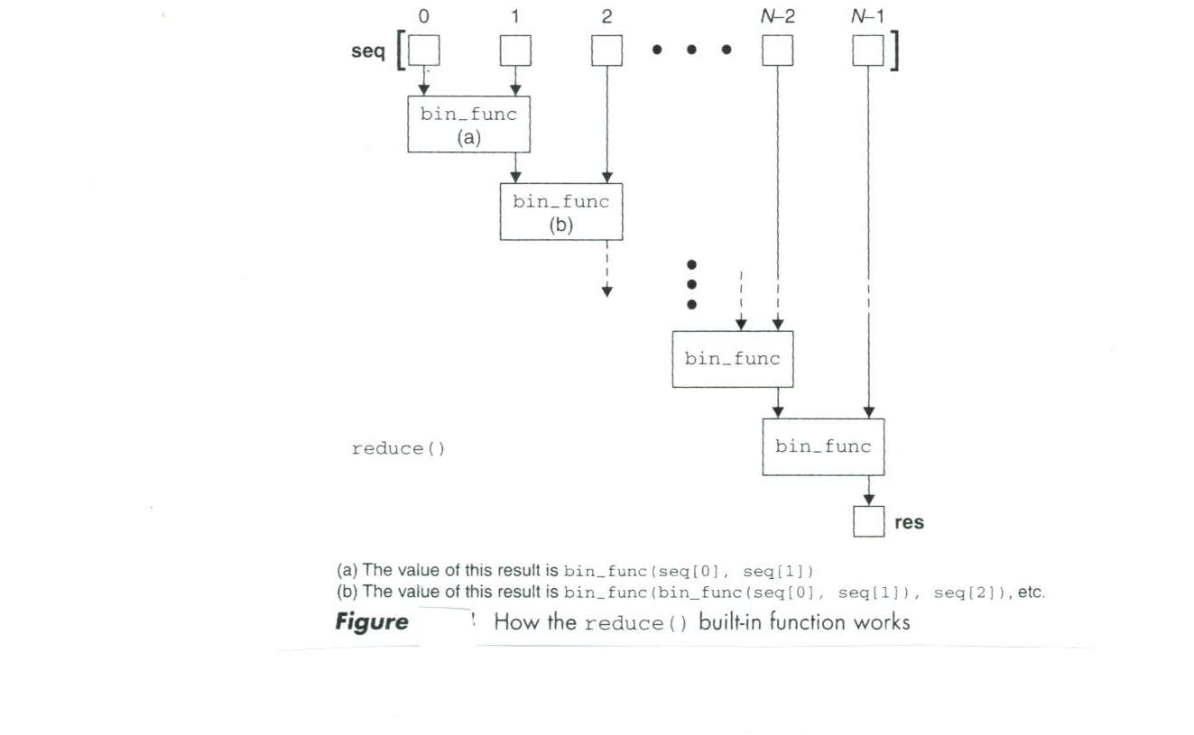
How reduce() works

Slide 28
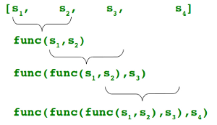
Illustration

Slide 29
reduce() : functionality description
def reduce (func, seq, init = None)
#func: needs to be binary function
lseq = list(seq) #convert to list
if init is None :
result = lseq : pop (0) #no
else :
result = init
for item in lseq :
result = func (result, item)
return res

Slide 30
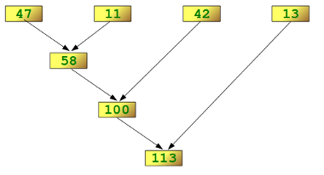
Example
>>> import functools
>>> functools.reduce(lambda x,y: x+y, [47,11,42,13])

Slide 31
Currying (partial functions)
A function of N arguments is “curried”
It applies to the 1st argument, and
It returns another function object taking the remaining N-1 arguments
>>>from operator import add, mul
>>>from functools import partial
>>>add5 = partial (add, 5)
>>>mul10 = partial (mul, 10)
>>>add5 (3)
>>>mul10(85)

Slide 32
Higher-order Functions in Lisp
Case studies
Lists as sets; Lists as sequences
Function as object
Passing function as argument
Lambda expressions
Higher-order functions
Apply, Funcall
Mapping functions
Recursive schemata
Functional Programming

Slide 33
Lists as Sets
A list that has no repeats among its top-level elements can be viewed as a representation of a set of its top-level elements
‘(3 1 4) is a set
‘(3 1 4 1) isn’t a set
Exercises:
write a function check_set which returns true if the list is a set, and nil if the list isn’t a set
write a function setify which makes a list a set, i.e.
(setify ‘(3 1 4 1)) -> (3 4 1) (or (3 1 4))
(setify ‘(a b b c a b b)) -> (c a b)
A number of pre-defined functions
member, union, nunion, intersection, nintersection, …

Slide 34
member function
Returns the part of the list beginning with the object it was looking for
>(member ‘A ‘(A B C))
(A B C)
>(member ‘B ‘(A B C))
>(B C)
>(member ‘D ‘(A B C))
nil
>(member ‘B ‘(A (B) C))
What will be returned?
>(member ‘(B) ‘(A (B) C))
What will be returned?

Slide 35
Member: with keyword arguments
:test argument
>(member ‘(a) ‘((b) (a) (z)) :test #’equal)
((a) (z))
In this example, with :test equal argument, it will use equal for comparison instead of eql
:key argument
>(member ‘a ‘((b d) (a b) (c d)) :key #’car)
((a b) (c d))
In this example, a function car is applied before comparison

Slide 36
>(member 2 ‘((1) (2)) :key #’car :test #’equal)
Same as
>(member 2 ‘((1) (2)) :test #’equal :key #’car)

Slide 37
Member-if
Find an element satisfying an arbitrary predicate
Example
>(member-if #’oddp ‘(2 4 3 8 9))
(3 8 9)

Slide 38
Union, intersection, difference
Takes two lists as arguments
>(union ‘(a b c) ‘(c b s))
(a b c s)
>(intersection ‘(a b c) ‘(c b s))
(b c )
>(set-difference ‘(a b c d e) ‘(b e))
(a c d)
Question: are you able to write functions for implementing union, intersection, etc.
nunion, nintersection
Same as union or intersection, but destroys the argument lists

Slide 39
subsetp
Checks if subset or not
>(subsetp ‘(1 2) ‘(1 3 5 2 6))
T
>(subsetp ‘(1 2) ‘(1 3 5 7 6))
nil

Slide 40
Lists as sequences
In common Lisp, sequences refers to both lists and vectors
Here we simply discusses relationship with lists
Sequence functions
Remove, length, reverse
We already used these functions
subseq
Sort
Predefined
Every, some

Slide 41
Sequence functions
>(subseq ‘(a b c d) 1 3)
(B C)
from position 1 to position 3 (not included)
2nd argument required; 3rd optional
note: position of a list starts from 0 to length-1
>(subseq ‘(a b c d) 1)
>(B C D)

Slide 42
>(sort ‘(0 2 1 3 8) #’>)
(8 3 2 1 0)
Sort based on descending order (>)
(sortedp Lst) predicate
>(every #’oddp ‘(1 3 5))
T
>(every #’oddp ‘(1 3 4 5 7))
Nil
>(some #’evenp ‘(1 2 3))
T
>(some #’evenp ‘(1 3 5))
Nil

Slide 43
Practice
List as strings (some string operations)
Write Lisp functions for the following:
Prefix
prefix (L1 L2): checks if L1 is a prefix of L2
Sublistp
Sublistp (L1 L2): checks if L1 is a sublist of L2
Exercises
Write a function (defun nthmost (n L) …) returns the nth greatest element of a list, e.g. (nthmost 2 ‘(0 2 1 3 8)) => 3
Write a function to check if a list is a palindrome or not

Slide 44
Functions as Objects
In Lisp, functions are regular objects.
Given the name of a function to function, it will return the associated object
>(function +)
#<compiled-function + 17BA4E>
(strange return value)
same as
>#’+
#< compiled-function + 17BA4E>

Slide 45
Passing functions as arguments
Apply
Can be given a number of arguments, but the last one must be a list
>(apply #’+ ‘(1 2 3))
6
>(apply #’+ 1 2 ‘(3 4 5))
15
Funcall
Does the same thing as apply but doesn’t need the arguments to be packed in a list
>(funcall #’+ 1 2 3)
6

Slide 46
Example
>(defun f (x) (+ x 2))
>(funcall #’f 5)
;any problem with it?
;if no problem, what will be the value?
>(apply #’f ‘5)
;any problem with it?
;if no problem, what will be the value?
>(apply #’f ‘(5))
;any problem with it?
;if no problem, what will be the value?

Slide 47
Practice
What will be returned by the following expression?
>(funcall #’List ‘A ‘B ‘C ‘D)
>(funcall #’Member ‘C ‘(A B C D))
>(apply #’List ‘A ‘B ‘C ‘(D E))
>(apply #’Member ‘(C (A B C D))

Slide 48
Apply vs. Funcall: Summary
(apply #’car ‘((a b c))) => A
(funcall #’car ‘(a b c)) => A
(apply #’cons ‘(a b)) => (A . B)
(funcall #’cons ‘a ‘b)) => (A . B)
(apply #’+ 1 2 ‘(3)) => 6
;last parameter must be a list
(funcall #’+ 1 2 3) => 6

Slide 49
Lambda
Lambda expression
(lambda arglist body)
e.g. (lambda (N) (+ 1 N))
>(funcall #‘(lambda (N) (+ 1 N)) 3)
4
>(apply #‘(lambda (A B C) (* A (+ B C))) ‘(4 3 5))
32
make sure you use #’ in front of the function parameter name

Slide 50
Practices
>(apply #’(lambda (x y) (cons x (cons x y)))
‘(do-be do))
>(apply #’(lambda (x y) (cons x (cons x y)))
‘do-be ‘(do))
>(apply #’(lambda (x y) (cons x (cons x y)))
‘do-be ‘((do)))
>(funcall #’(lambda (a b) (sqrt(+ (* a a) (* b b)))) (- 4 1) (- 3 7))
>(funcall #’(lambda (A &REST B) (Member A B))
‘x ‘u ‘v ‘w ‘x ‘y)

Slide 51
Mapping Functions
Mapping function
Applied successively to elements of one or more lists
Mapcar (mapcar fun arglist-1 … arglist-n)
Applies to car of each arglist-i, then applied to cadrs (i.e. (car (cdr arglist-i)), that is, to first element, to second element, …
>(mapcar #’numberp ‘(A 3 B 2 4))
(nil T nil T T)
>(mapcar #’(lambda (n) (+ 1 n)) ‘(5 3 6 7 2))
(6 4 7 8 3)

Slide 52
Mapcar Examples
(defun double (x) (* 2 x)
(mapcar #’double ‘(1 2 3)) => (2 4 6)
(mapcar #’sqrt ‘(1 2 3 4))
=> (1 1.4132135 1.7320508 2)
(mapcar #’oddp ‘(1 2 3)) => (T nil T)
(mapcar #’(lambda (x) (1+ (* 2 x))) ‘(1 2 3))
=> (3 5 7)

Slide 53
Maplist
Maplist
Applied to the list first, then to the cdr, …
>(maplist #’(Lambda(list) (apply #’+ list)) ‘(5 3 6 7 2))
(23 18 15 9 2)
First applied to the list ‘(5 3 6 7 2)
Then to (3 6 7 2)
Then to (6 7 2)
Then to (7 2)
Then to (2)

Slide 54
More Mapping Functions
Mapcan and Mapcon
Mapcan similar to mapcar except is uses nconc
Mapcon is similar to maplist except it uses nconc
Mapc and Mapl
mapc/mapl similar to mapcar/maplist except it doesn’t cons up the result in a list
Only used in side-effect
(mapc #’(lambda (x y) (format t “~A ~A “ x y))
‘(hip flip slip) ‘(hop flop slop))
hip hop flip flop slip slop ;from side-effect -- format
(hip flip slip) ;it returns the first list as return value

Slide 55
Mapc Example
(defun sum (L)
(let ((result 0))
(mapc #’(lambda (x) (setf result (+ result x))) L)
result
) ;end of let
)
(sum nil) -> 0
(sum ‘(3 1 4 1))=> 9

Slide 56
Functional value of a symbol
(BOUNDP symbol)
Returns nil if the symbol has never been bound a value in the global environment, otherwise returns T
>(defun f (x) (+ 1 x))
>(boundp ‘+) -> T
>(boundp ‘f) -> T
>(setf a 3)
>(boundp ‘a) -> T
(FBOUNDP symbol)
Returns nil if the symbol doesn’t have a functional definition, otherwise returns T
>(fboundp ‘+) -> T
>(fboundp ‘f) -> T
>(fboundp ‘g) -> nil
>(fboundp ‘a) -> nil

Slide 57
(SYMBOL-FUNCTION symbol)
Retrieves the definition of the symbol
>(symbol-function 'f)
#<FUNCTION F (X) (DECLARE (SYSTEM::IN-DEFUN F)) (BLOCK F (+ 1 X))>
(functionp obj)
Test if obj is a true functional object. If it is, such obj can be passed to funcall or apply along with its arguments
>(functionp (symbol-function ‘f)) -> T
>(functionp (symbol-function ‘length)) -> T

Slide 58
Application
Using LISP to build up an interpreter
(defun the-eval (expr) …)
Algorithm:
if exp is a cons list,
let fun-name = (car expr)
arg-lst = (cdr expr)
if (fun-name == ‘quote) return (car arg-lst)
else if (fun-name is a defined function)
recursively call the-eval to each arg and
then apply the function to arg-lst
else unknown function

Slide 59
Recursive Schemata
Families of recursive functions which may help in solving Lisp problems. Each schema (plural schemata) represents a whole family of recursive functions which are similar in code.

Slide 60
ACC-ALL
ACC-ALL (accumulate-all) takes a list and returns a scalar derived from using every element of the list
(defun ACC-ALL (L)
(cond ((null L) base_val)
(T (acc-op fn (ACC-ALL (cdr L))))
)
)
(SUM ‘(3 1 4 1)) -> 9
(LEN ‘(3 1 4 1)) -> 4
(SUMSQ ‘(3 1 4)) -> 26
 | base-val | acc-op | fn
Len | 0 | + | 1
Sum | 0 | + | (car L)
Prod | 1 | * | (car L)
SumSq | 0 | + | (* (car L) (car L)

Slide 61
ACC-Some
ACC-SOME (accumulate-some) takes a list and returns a scalar derived from using only some elements of the list
(defun ACC-SOME (L)
(cond ((null L) base_val)
((test (car L)) (acc-op fn
(ACC-SOME (cdr L))))
(T (ACC-SOME (cdr L)))))
(COUNT-ODD ‘(3 1 4 1)) -> 3
(SUM-ODD ‘(3 1 4 1)) -> 5
(COUNT# ‘(A 1 2 B 3)) -> 3 (SUM# ‘(A 1 2 B 3)) -> 6
 | base-val | Acc-op | test | fn
Count-odd | 0 | + | oddp | 1
Count# | 0 | + | numberp | 1
Sum-odd | 0 | + | Oddp | (car L)
Sum# | 0 | + | numberp | (car L)

Slide 62
OP-All
OP-ALL (operate-all) takes a list and returns a list of the same length, but operates on every element
(defun OP-All (L)
(cond ((null L) nil)
(T (cons (f (car L)) (OP-All (cdr L))))))
Examples
(SQ-ALL ‘(3 1 4 1)) –> (9 1 16 1)
(INC-ALL ‘(3 1 4 1)) -> (4 2 5 2)
(LISTIFY-ALL ‘(A 2 B)) -> ((A) (2) (B))
(Double-ALL ‘(3 1 4 1) -> (6 2 8 2)

Slide 63
OP-Some
OP-SOME (operate-some) takes a list and returns a list of the same length, but operates on only some elements.
(defun OP-SOME (L)
(cond ((null L) nil)
((test (car L))
(cons (f (car L)) (OP-SOME (cdr L))))
(T (cons (car L) (OP-SOME (cdr L))))))
Examples
(SQ-ODD ‘(3 5 4 7)) -> (9 25 4 49)
(INC-ODD ‘(3 5 4 7)) -> (4 6 4 8)
More: DOUBLE-EVEN, INC#, …

Slide 64
KEEP-SOME/DELETE-SOME
KEEP-SOME/DELETE-SOME takes a list and returns another list, keeping/deleting some of the elements
(KEEP-ODD ‘(3 1 4 1)) -> (3 1 1)
(TOSS-ODD ‘(3 1 4 1)) -> (4)
More: KEEP-EVEN, KEEP#, KEEP-PS (perfect square), DEL-ODD, …

Slide 65
ALL
ALL takes a list and determines if every element possesses some particular property.
(ALL-ODD ‘(3 1 4 1)) -> nil
(ALL-ODD ‘(1 9 9 9)) -> t

Slide 66
ANY
ANY takes a list and determines if any element possesses some particular property.
(SOME-ODD ‘(3 1 4 1)) -> t
(SOME-ODD ‘(2 4 6)) -> nil

Slide 67
Every, Some
Every, some
(every #’oddp ‘(3 1 3 7 1)) -> T
(every #’oddp ‘(3 4 1 7)) -> nil
(some #’oddp ‘(3 4 1 7)) -> t
;perfect square
(defun perfsq (N)
(let ((root (round (sqrt N)))) (= N (* root root))))
(every #’perfsq ‘(1 4 9)) -> t

Slide 68
Functional Programming
What is functional programming
Writing functional programs
Functional programs
Work by returning values
Not by modifying things
Not treat modifying object status as the semantics of the program
Not for side effect
Dominant paradigm in Lisp

